Slide 1
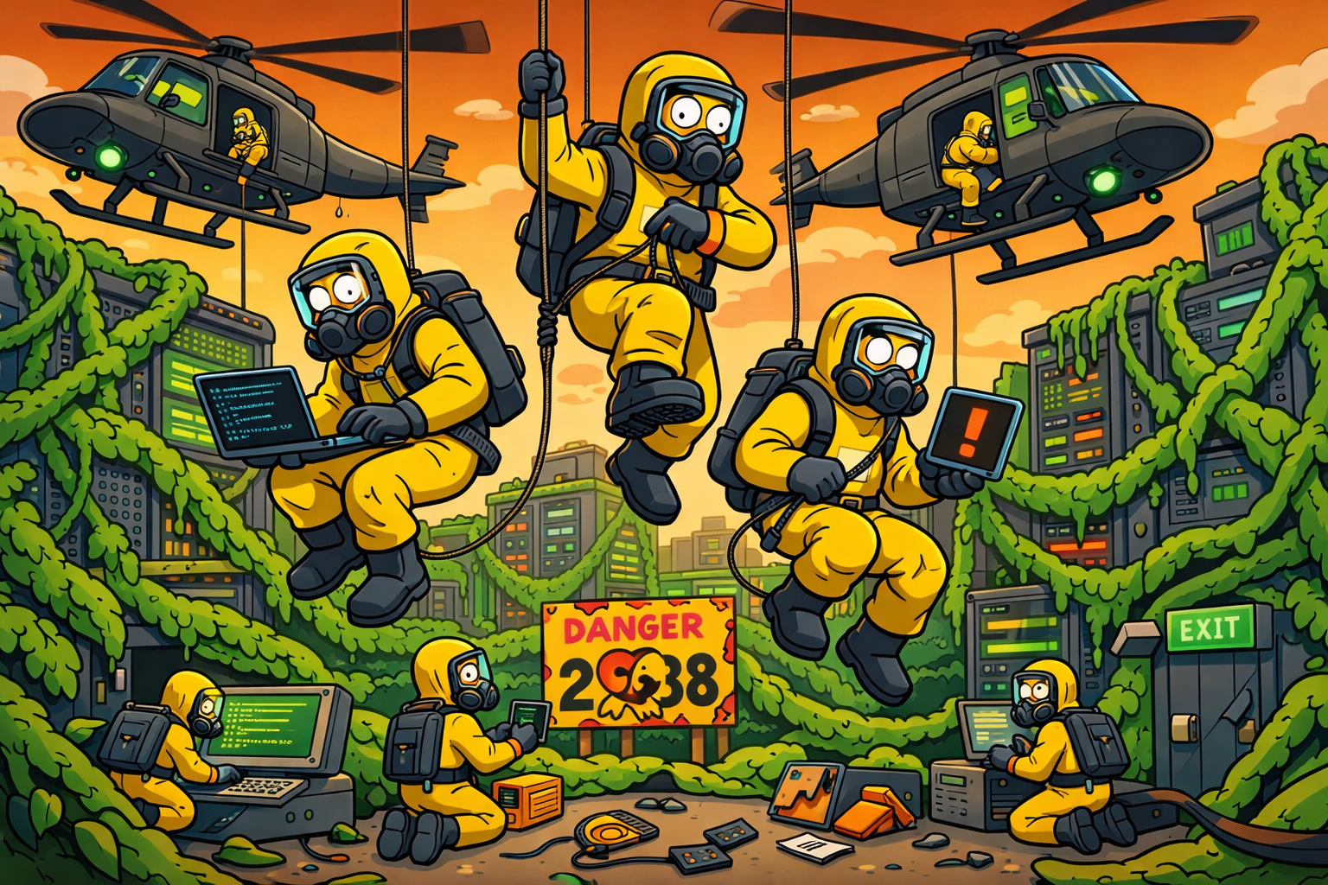
Pulling 32-bit time_t Asbestos Out of the Open Source Ecosystem
Room: H.3242 Time: 15:00–15:55 Group Facilitator: Trey Darley CC BY 4.0: Trey Darley
Trey Darley FOSDEM BoF 2026-01-31
01/29
Notes:
SECTION 1 — CONTEXT SETTING (10-12 minutes)
Goal: Establish shared language and urgency without lecturing.
FACILITATOR REMINDERS
You are the convener, not the expert
Make space for the room
Protect the Ascent — that's where the leverage is
Silence is okay — let people think
Park threads if needed, but follow up
Within 48 hours: share contact list, send notes, personal follow-up with 2-3 engaged participants
MATERIALS
Whiteboard / flipchart (optional but useful for capturing themes)
3+ marker colors
Sign-up sheet or QR code for contact exchange
Timer (phone is fine — keep it visible to yourself)
Water
Slide 1 — Pulling 32-bit time_t Asbestos Out of the Open Source Ecosystem
A collaborative working session on mapping, triaging, and coordinating 2038-class remediation
(~0:60 for BoF pacing)
⏱ START TIMER: 0:00
Thanks for being here.
Quick intro: I'm Trey Darley.
I run a small consultancy, Proper Tools, focused on systemic infrastructure risk.
I'm also one of the editors on the ITU-T — that's the UN telecom standards body — Study Group 17 draft technical report on 2038 coordination requirements
I chair the FIRST.org Time Security SIG, which is one home for this work.
One request before we start: I'd love a volunteer who's good at taking notes.
Email me yours afterward — hello@propertools.be — and I'll credit you as a contributor in future versions of this workshop.
[nod to any takers, move on]
This is a BoF, not a talk.
I’ll set some context, but most of the value will come from the room.
The goal is to leave knowing people you didn’t know before —
and having stress-tested how we’d respond if someone powerful started asking hard questions about 2038.
FACILITATOR NOTES
Timing: 0:20-0:30
Purpose: Set expectations, establish tone, name the goal
Key beats:
This is a BoF, not a lecture
Value comes from the room
Goal: connections + stress-testing our collective response
Delivery notes:
Warm, welcoming energy
Make eye contact across the room
Don't rush — this sets the tone for everything
Watch for:
Are people settling in or still arriving? Adjust pace accordingly
Laptop lids open/closed — signals engagement level
© 2026 Proper Tools. Licensed under CC BY 4.0. Attribution required; commercial use permitted.

Slide 2
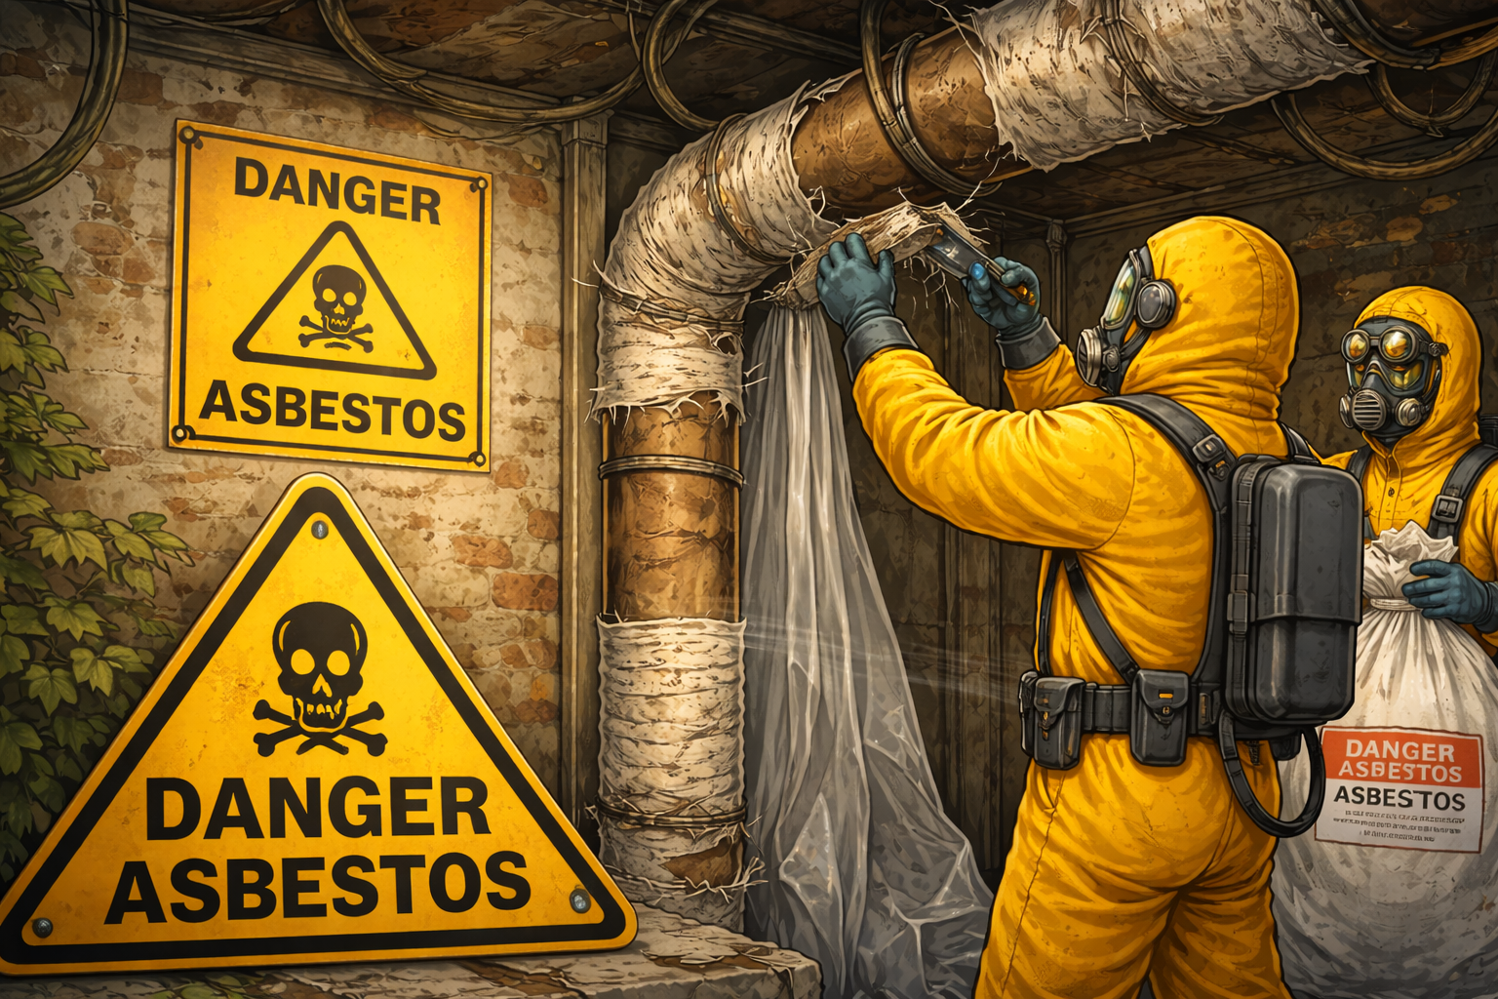
But We Were Doing Asbestos We Could Back Then…
Trey Darley FOSDEM BoF 2026-01-31
02/30
Notes:
Slide 2 — But We Were Doing Asbestos We Could Back Then
(~1:00 for BoF pacing)
⏱ START TIMER: 0:60
Quick context check — asbestos, a once-common building material now known to be highly carcinogenic..
Miracle material.
Fireproof, cheap, strong.
From the 1920s through the 1970s, it went into everything — insulation, pipes, roofing, floor tiles.
The problem: it causes cancer.
But not immediately — decades later.
By the time we understood the danger, it was already load-bearing, in the walls of millions of buildings.
And you can't just rip it out.
[BEAT]
Removal aerosolizes the fibers — makes it worse.
You need careful, coordinated remediation.
Asbestos in your hospital?
You may need to relocate entire departments.
The remediation itself becomes the risk.
That's today's metaphor.
32-bit time assumptions are the asbestos of the open source ecosystem.
Load-bearing. Everywhere.
Dangerous to remove carelessly.
Requires coordination.
[beat]
Let's talk about how we got here.
FACILITATOR NOTES
Timing: 0:45
Purpose: Establish the central metaphor for the session
Key beats:
Miracle material → delayed harm → load-bearing by the time we knew
Can't just rip it out — remediation itself is risky
32-bit time_t = asbestos of open source
Delivery notes:
[BEAT] after "you can't just rip it out" — let it land
"Load-bearing. Everywhere. Dangerous to remove carelessly." — slow, declarative
The pun in the title is intentional — if people groan, you're doing it right
Watch for:
Recognition vs. confusion — younger/non-Western audiences may not know asbestos
If faces look blank, add: "If you haven't encountered asbestos — it's a building material that's now banned in most countries because it kills you slowly."
© 2026 Proper Tools. Licensed under CC BY 4.0. Attribution required; commercial use permitted.

Slide 3
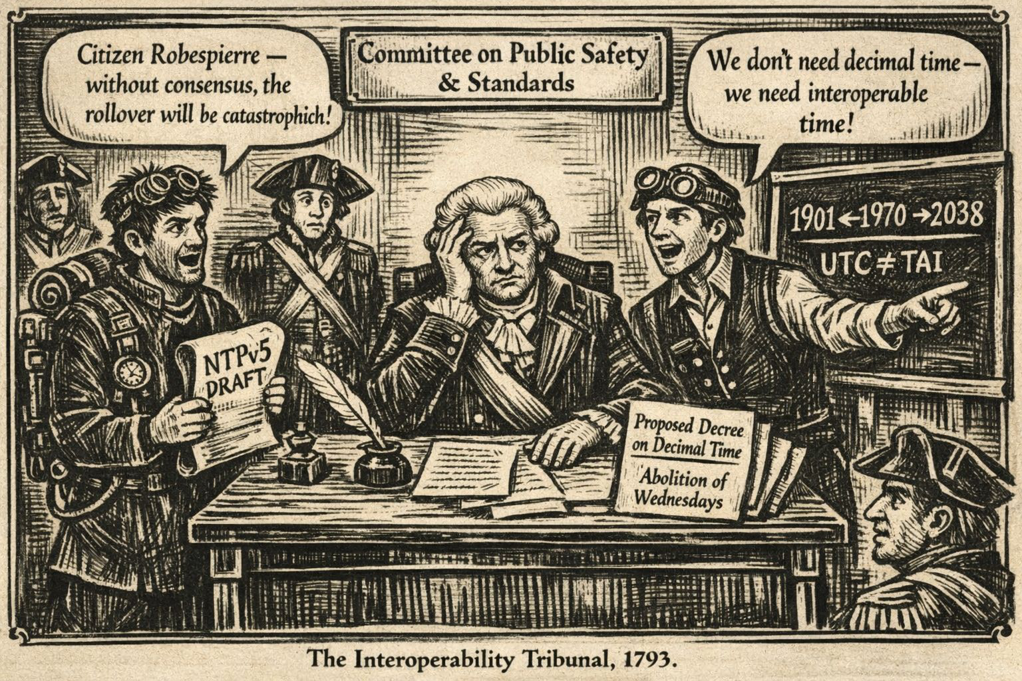
How We Got Here (A Short, Embarrassing History of Time)
Trey Darley FOSDEM BoF 2026-01-31
Notes:
Slide 3 — How We Got Here (A Short, Embarrassing History of Time)
(~1:30 for BoF pacing)
⏱ START TIMER: 2:00
Before we talk about 2038, I want to explain how we got here — because this isn't a story about bad engineers or legacy systems.
It's a story about humans trying very hard to avoid doing calendar math.
[gesture to slide]
Time math is genuinely hard.
The Sumerians gave us base-60 — barely adequate for tracking the moon, and we said 'sure, let's use that for distributed systems.'
Leap seconds. Leap years.
Daylight saving.
Time zones that change when governments get bored.
The Julian-to-Gregorian transition deleted eleven days and caused riots.
The French Revolution tried to fix this.
Decimal time: ten-hour days, hundred-minute hours.
Rational. Clean.
The world refused.
Robespierre was decapitated before the standard reached consensus.
Therefore — in a narrow but technically defensible sense — 2038 is entirely Robespierre's fault.
[wait for laugh]
By the 1970s, the people building Unix didn't say 'let's design planetary infrastructure.'
They said: 'give us anything that avoids calendar math.'
So they counted seconds.
Seconds since 1970.
Signed 32-bit integer.
On a PDP-11, 68 years felt like forever.
Nobody thought this AT&T research project would still be running in 2026.
Once that pattern existed, it spread everywhere — not because it was beautiful, but because it was cheap, portable, and good enough.
Databases, protocols, embedded devices, telecom, SCADA.
The 2038 rollover isn't a surprise.
It's just the date where a human cognitive shortcut collides with integer overflow.
So today isn't about blame.
We inherited this mess for reasonable reasons.
The question is: how do we clean it up together?
Let's look at where the contamination actually lives.
FACILITATOR NOTES
Timing: 1:30
Purpose: Establish historical context with humor; explain why this happened without assigning blame
Key beats:
Time math is inherently awful — not a software problem
Robespierre joke — earns attention, releases tension
Unix was pragmatic, not careless
Pattern spread because it worked
Not about blame — we inherited this; now we coordinate
Delivery notes:
"Time math is bullshit" — say it like a fact, not a joke
Robespierre line: deadpan delivery, then [wait for laugh] — don't step on it
The list (leap seconds, leap years, etc.) can be rapid-fire
"cheap, portable, and good enough" — land each word
Transition line ("Let's look at where the contamination actually lives") — slightly slower, signals shift
Watch for:
Laughter at Robespierre line — if it lands, you've got them
History buffs may want to engage — park if needed ("love to talk after")
If energy dips during Unix history, pick up pace
© 2026 Proper Tools. Licensed under CC BY 4.0. Attribution required; commercial use permitted.

Slide 4

The Contamination Frame
Not legacy — still shipping
time_t assumptions baked into: libc, protocols, serialization formats, firmware, toolchains
You can't grep your way out
Asbestos in the walls of the open source ecosystem
Trey Darley FOSDEM BoF 2026-01-31
04/30
Notes:
Slide 4 — The Contamination Frame
(~1:00 for BoF pacing)
⏱ START TIMER: 3:30
So what does that contamination actually look like?
It's not old Unix boxes in a closet.
32-bit time assumptions are still being compiled into production code today —
in libraries, protocols, firmware that won't see an update for fifteen years.
It's load-bearing.
It's everywhere.
You can't just rip it out.
That's why this BoF exists: to map where the contamination is, and figure out how we coordinate to remove it.
You — the maintainers, packagers, tooling authors — are the remediation crew.
FACILITATOR NOTES
Timing: 0:30
Purpose: Connect metaphor to reality; name the room's role
Key beats:
Not legacy — still shipping today
Load-bearing, everywhere, can't rip out
This BoF = mapping + coordination
You (the room) are the remediation crew
Delivery notes:
Quick, declarative energy — no pauses until the final line
"Load-bearing. It's everywhere. You can't just rip it out." — three beats, land each one
Final line ("You — the maintainers...") — slow down, make eye contact across the room
This is the first time you're telling them they have a role; let it register
Watch for:
Nods of recognition — they've seen this in their own work
Skeptical faces — they may need proof (coming in Slide 6)
If someone looks like they want to speak, note them for discussion later
© 2026 Proper Tools. Licensed under CC BY 4.0. Attribution required; commercial use permitted.

Slide 5
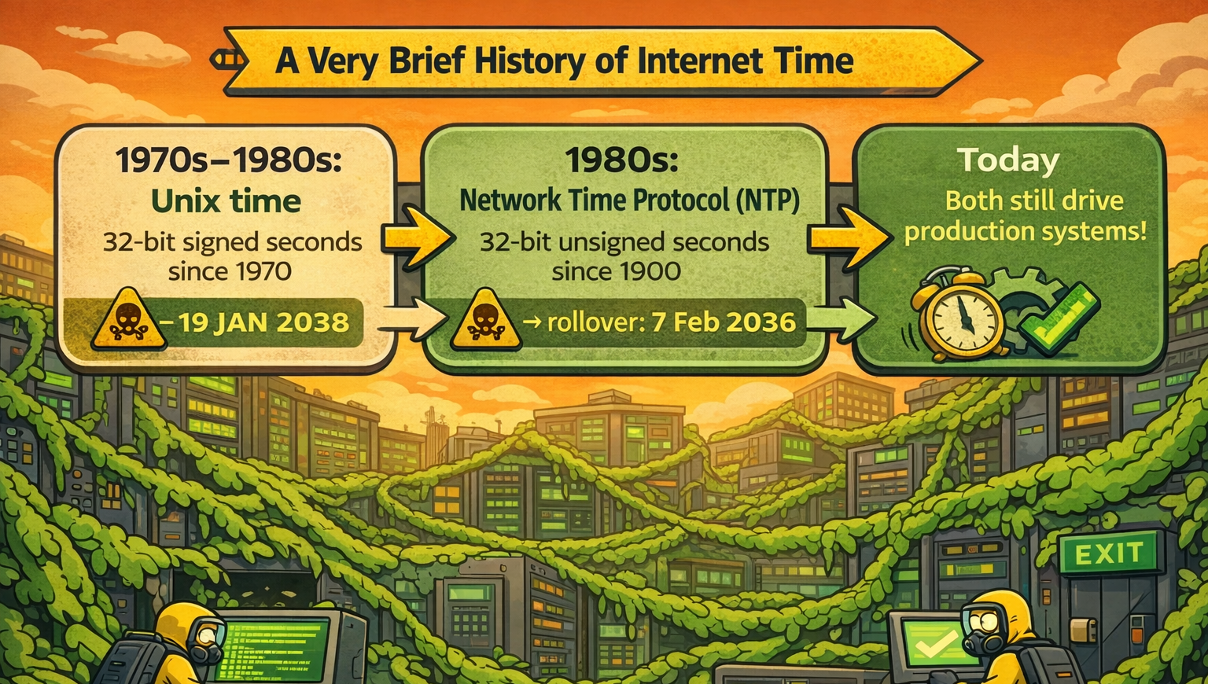
Trey Darley FOSDEM BoF 2026-01-31
05/30
Notes:
Slide 5 — A Very Brief History of Internet Time
(~1:00 for BoF pacing)
⏱ START TIMER: 4:30
Two protocols, two epochs, two rollovers — same 32-bit constraint.
Unix time wraps January 2038. NTP wraps February 2036.
NTP breaks first.
The patches for NTP's rollover shipped in 2009-2010.
The fix has been available for fifteen years.
And yet — as of 2025, BitSight's published scan data shows roughly one-third of publicly visible NTP servers are still running vulnerable implementations.
[let that land]
Fifteen years of patches.
One-third still exposed.
So when someone tells you 2026 is 'too early' to coordinate on 2038 — ask them to explain NTP.
The coordination problem isn't theoretical.
We're watching it fail in real time, on a protocol with a known fix and a known deadline.
If your remediation plan assumes you have until 2038, you're already late.
NTP proves it.
FACILITATOR NOTES
Timing: 0:45-0:50
Purpose: Establish that coordination failure is already observable; preempt "we have time" objection
Key beats:
NTP breaks first (2036)
Fix available for 15 years; one-third still exposed
"Ask them to explain NTP" — the rhetorical kill shot
You're already late
Delivery notes:
"NTP breaks first" — let it land, slight pause
"Fifteen years of patches. One-third still exposed." — slow, deliberate
"Ask them to explain NTP" — direct, almost a challenge
Watch for:
This slide may produce visible reactions — furrowed brows, people writing notes
Someone may want to challenge the BitSight data — park it: "Happy to share the source afterward"
If NTP isn't familiar to some, don't explain — the point lands anyway
© 2026 Proper Tools. Licensed under CC BY 4.0. Attribution required; commercial use permitted.

Slide 6
What Testing Actually Shows
Forward-time testing on x86_64: dozens of failures
Only one would be improved by a glibc change → the rest live in application logic, protocols, and build systems†
Real bugs already surfaced: MariaDB, memcached, libarchive, libzypp, FreePascal
Special thanks to Bernhard M. Wiedemann, openSUSE
†Alpine/musl succeeded because they had no legacy binary ABI constraints.
Trey Darley FOSDEM BoF 2026-01-31
06/30
Notes:
Slide 6 — What Testing Actually Shows
(~1:30 for BoF pacing)
⏱ START TIMER: 5:30
(Bernhard M. Wiedemann, openSUSE)
Before we continue towards discussion, let's anchor in what real testing actually shows.
Bernhard Wiedemann at openSUSE — some of you may know him from the yearly 2038 posts on r/Linux — has been doing systematic forward-time testing.
Clock set forward to 2038 to observe failure modes..
On x86_64, where time_t is already 64-bit, he found dozens of failures.
Only one would have been helped by a glibc change.
The rest live in application logic, protocols, build systems — above the C library.
These aren't theoretical.
Real bugs, in issue trackers today: MariaDB, memcached, libarchive, openSUSE's own package manager, FreePascal.
Competing with everything else for attention.
[Maybe skip Alpine discussion, read the room]
Now, someone might point to Alpine — they transitioned cleanly.
True, but musl was 64-bit from the start and they recompile everything.
No legacy ABI constraints.
For glibc ecosystems, that option doesn't exist.
Transition: With that grounding — let's look at where the contamination actually lives.
FACILITATOR NOTES
Timing: 1:30
Purpose: Ground the session in real data; preempt "isn't glibc fixed?" objection
Key beats:
Real testing, real failures — not speculation
64-bit time_t doesn't save you — problems live above glibc
Named bugs in real projects (MariaDB, memcached, etc.)
Alpine isn't a counterexample — different constraints
Delivery notes:
Credit Bernhard by name — this is his work
"Only one would have been helped by a glibc change" — pause, let it register
List the bug names — specificity builds credibility
"For glibc ecosystems, that option doesn't exist" — land it with finality
Watch for:
glibc maintainers or distro packagers in the room may nod or want to add context — note for discussion
"What about [X distro]?" questions — park: "Great question for discussion"
Skepticism about the testing methodology — "Bernhard's documented his approach, happy to share links"
© 2026 Proper Tools. Licensed under CC BY 4.0. Attribution required; commercial use permitted.

Slide 7
When Testing Becomes the Problem
Forward-time testing breaks TLS by design
Certificates expire before deeper failures surface
“Just disable TLS” is not a realistic test strategy
We lack a scalable, trusted way to test the future†
†We need a broader testing discussion with ICANN.
Trey Darley FOSDEM BoF 2026-01-31
07/30
Notes:
Slide 7 — When Testing Becomes the Problem
(~1:30 for BoF pacing)
⏱ START TIMER: 7:00
One specific testing issue keeps coming up: TLS certificate validity.
When you push the clock forward, TLS correctly starts failing.
Certificates expire.
OCSP fails.
Handshakes break.
That's not a bug — that's the security model working as designed.
But TLS failures often happen before we reach the deeper code failures we're trying to surface.
Forward-time testing gets stuck at the crypto perimeter.
[BEAT]
People respond by disabling certificate validation, patching trust stores, running ad-hoc test CAs.
Tests pass — but realism, comparability, and trust in results are gone.
There is no widely agreed, scalable way to test systems far into the future without breaking the public trust infrastructure.
That's not a glibc problem.
That's not even a TLS problem.
That's a coordination problem — one we haven't solved yet.
Keep that in mind as we go deeper: the thing that's supposed to protect you becomes the thing that blocks you from seeing what's coming.
FACILITATOR NOTES
Timing: 1:15
Purpose: Surface a non-obvious testing barrier; reinforce coordination theme
Key beats:
TLS fails by design when you time-travel
Testing gets stuck at the crypto perimeter
Workarounds destroy the validity of results
No scalable solution exists — coordination gap
Pattern: protection becomes obstruction
Delivery notes:
"That's not a bug — that's the security model working as designed" — slight pause, let the irony land
The triplet ("not a glibc problem / not even a TLS problem / coordination problem") — build rhythm, land the third
Final line is the takeaway — slow down, make it memorable
Watch for:
Security folks may light up — this is their domain
Someone may have a workaround to share — note for discussion
If energy dips (this is technical), pick up pace
© 2026 Proper Tools. Licensed under CC BY 4.0. Attribution required; commercial use permitted.

Slide 8
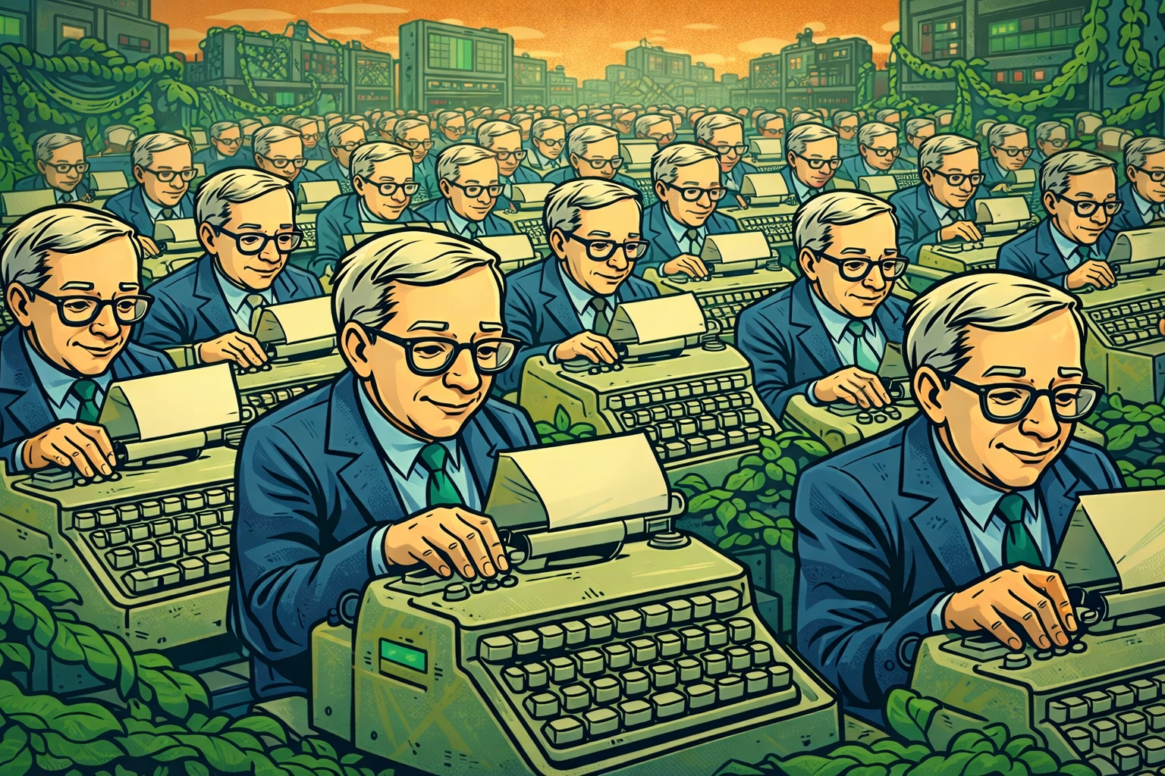
Let's Talk About Vibe Coding!
Trey Darley FOSDEM BoF 2026-01-31
08/30
Notes:
Slide 8 — Let's Talk About Vibe Coding
(~1:00 for BoF pacing)
⏱ START TIMER: 8:30
One more thing — and this is getting worse as we speak.
LLMs are trained on the existing codebase of the internet.
Decades of code.
And what does that corpus contain?
Decades of 32-bit time_t assumptions.
When someone vibe-codes a timestamp problem — 'just make it work' — the LLM reaches for the statistically most common pattern.
Which is exactly the pattern we're trying to remediate.
[BEAT]
You know the old joke — a million monkeys will eventually reproduce Shakespeare.
Turns out we got a million Stephen Hawkings reproducing 1987 at industrial scale.
[beat]
No guardrails by default.
No lint rule that says 'this will fail in 2038.'
No warning that this format can't represent dates past the epoch.
We spent fifty years accumulating this debt.
Now we're training machines to propagate it faster than humans ever could.
The contamination isn't just legacy.
It's being actively synthesized by tools that have no idea what year it is.
If you're working on AI code assistants, developer tooling, or static analysis — time-dependency awareness should be a first-class concern.
Right now, it's not on the radar.
FACILITATOR NOTES
Timing: 0:50
Purpose: Name an accelerating risk; call to action for tooling folks
Key beats:
LLMs trained on 32-bit assumptions
Statistically correct ≠ temporally safe
Stephen Hawking joke — releases tension, makes it memorable
No guardrails exist
Active synthesis of contamination — not just legacy
Delivery notes:
[beat] after "pattern we're trying to remediate" — let the problem land
Stephen Hawking line: deadpan, wait for the laugh
"No guardrails. No lint rule. No warning." — rapid triplet
Final call to action — direct eye contact with anyone who looks like a tooling person
Watch for:
AI/ML folks may react strongly — this is their domain
Someone may know of existing lint rules or tooling — great, note for later
Chuckles at the Hawking line — if it lands, energy is good
© 2026 Proper Tools. Licensed under CC BY 4.0. Attribution required; commercial use permitted.

Slide 9
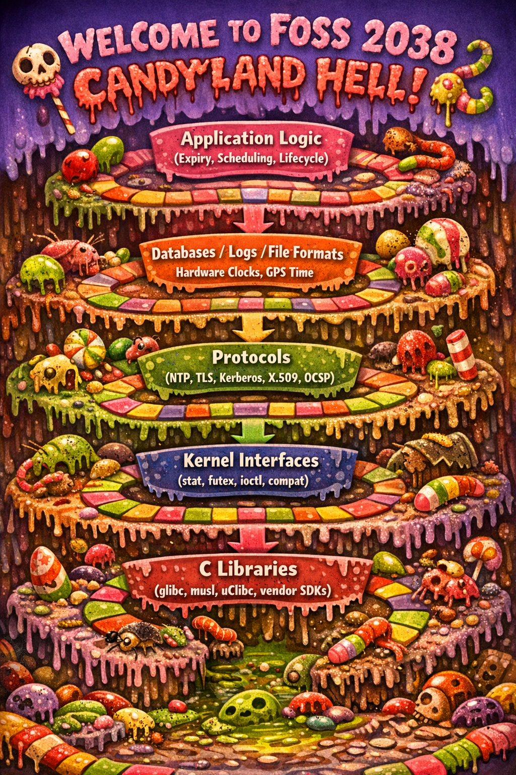
Where 32-bit time_t Actually Lives
Trey Darley FOSDEM BoF 2026-01-31
09/30
Notes:
SECTION 2 — THE DESCENT (15-20 minutes)
Goal: Surface real technical constraints and tooling gaps. Open the floor.
Slide 9 — Where 32-bit time_t Actually Lives
(~0:45 for BoF pacing)
⏱ START TIMER: 9:30
This is where the contamination actually lives.
When someone says 'glibc is fixed,' they're pointing at one layer.
But the assumptions propagate upward — through kernel interfaces, into protocols, into databases and file formats, all the way up to application logic.
Every layer has its own remediation timeline, its own maintainers, its own coordination problem.
We can't walk through every layer now — but this is the map.
This is where it lives.
Every layer has a different owner.
None of them can fix this alone.
Keep this in mind as we move on.
This requires coordination.
FACILITATOR NOTES
Timing: 0:45
Purpose: Present the full stack; set up discussion
Key beats:
glibc is one layer, not the whole problem
Contamination propagates upward
Every layer = different owners, different timelines
This is the map for the discussion to come
Delivery notes:
Gesture to the slide as you walk up the stack
"None of them can fix this alone" — land it, slight pause
This is a transition slide — energy should build toward opening discussion
Watch for:
People studying the diagram — they're locating themselves
Someone wanting to add a layer or challenge the model — note for discussion
This may trigger "what about X?" energy — that's exactly what you want for the next slide
© 2026 Proper Tools. Licensed under CC BY 4.0. Attribution required; commercial use permitted.

Slide 10
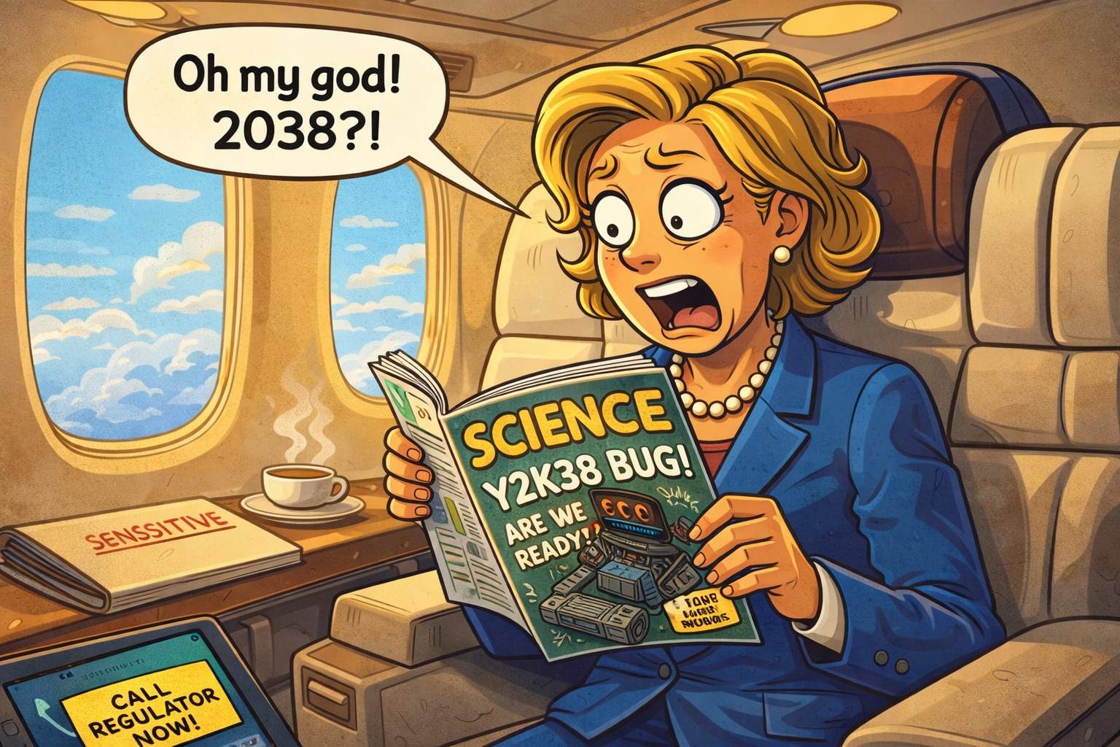
The 12-Week Scenario
Trey Darley FOSDEM BoF 2026-01-31
10/30
Notes:
Slide 10 — The 12-Week Scenario
(~1:30 for BoF pacing)
⏱ START TIMER: 10:30
Here's the scenario.
Your prime minister — or your CEO, or your regulator, or your customer — reads about 2038 on a flight.
Hopefully it's a science magazine.
Magazine cover story, briefing note — doesn't matter.
What matters: now they're asking questions.
You get a call.
Your organization needs a risk assessment in 12 weeks.
High, medium, or low exposure — and what's your confidence level?
You're asked to lead the response.
You get budget.
You get ten people.
Not two hundred. Ten.
Already busy. Clock already running.
So: where do you actually start?
Who do you call?
What's your first query?
What's the first system you check?
What's your first blind spot — the known-unknown that keeps you up at night sometimes?
That's what we're exploring together today.
We'll play the scenario forward — down into the technical weeds, then back up to the ministerial brief.
FACILITATOR NOTES
Timing: 1:30
Purpose: Establish the scenario that frames both discussions
Key beats:
Someone powerful is now asking questions
12 weeks, 10 people, already busy — real constraints
Where do you start? — the central question
Known-unknowns — this is what the room will surface
Delivery notes:
Start timer visibly — creates productive urgency
"Ten. Already busy. Clock already running." — staccato, let the pressure build
The four questions (who/what/first system/blind spot) — slow down, let them land
Final line ("down into the weeds, back up to the brief") — previews the arc
Watch for:
People mentally placing themselves in the scenario — good
Anxiety or resistance — reassure: "This is a thought experiment, not a test"
Someone already wanting to answer — hold them: "We'll open it up in a moment"
© 2026 Proper Tools. Licensed under CC BY 4.0. Attribution required; commercial use permitted.

Slide 11
BoF Working Norms
One mic
No solutions without concrete examples
Step up / step back
I may park threads to protect time
Trey Darley FOSDEM BoF 2026-01-31
11/30
Notes:
Slide 11 — BoF Working Norms
(~0:30 for BoF pacing)
⏱ START TIMER: 12:00
Quick working norms before we dive in.
One mic — raise your hand and I'll get to you.
No solutions without concrete examples — ground it in something real.
Step up if you haven't spoken; step back if you have.
I may park threads to protect the clock — nothing personal.
Grab me afterward if I park something you care about.
Alright. Let's get into it.
FACILITATOR NOTES
Timing: 0:30
Purpose: Establish discussion norms; give yourself permission to facilitate
Key beats:
One mic — you control the flow
Concrete examples — keeps it grounded
Step up / step back — balances voices
Parking is allowed — protects time for Ascent
Delivery notes:
Brisk, confident energy — these are norms, not negotiations
"Nothing personal" with a slight smile — keeps it light
"Let's get into it" — energy shift, opens the floor
Watch for:
Nods of acknowledgment — they've accepted the contract
Anyone looking confused by "step up / step back" — you can clarify: "Make space for new voices"
This slide is quick — don't linger
© 2026 Proper Tools. Licensed under CC BY 4.0. Attribution required; commercial use permitted.

Slide 12
Seed Questions
Where do you actually start on Monday morning?
Who has tried to enumerate time_t exposure — and what surprised you?
Pick one system you know well. Where would you start? What helps with testing? What’s missing?
Trey Darley FOSDEM BoF 2026-01-31
12/30
Notes:
Slide 12 — Seed Questions
(~0:30 setup + 8-10 min discussion)
⏱ START TIMER: 12:30 ⏱ STOP TIMER: 23:00
This is our room. I'll mostly listen.
Ten seconds to think — then I'll pick someone to start.
[10 seconds silence]
Okay: who in this room has actually set a system clock to 2038 and watched something break?
[take first hand, or pick someone who looks ready]
That's a great place to start…
FACILITATOR NOTES
Timing: 0:30 setup, then 8-10 minutes open discussion
Purpose: Discussion — open the floor; surface real experiences from the room
Key beats:
"This is our room" — shifts ownership to participants
Silence is intentional — let people think
The narrowed question is your backup if no one bites on the open prompt
First speaker sets the tone — pick someone who looks engaged
Delivery notes:
"I'll mostly listen" — means it; step back physically if you can
Count the ten seconds in your head — it will feel longer than it is; don't rush
If no hands after the narrowed question, call on someone directly: "You look like you've seen some things — what's your slice of this?"
"That's a great place to start" — validates first speaker, invites follow-on
Seed questions on slide (for room):
Where do you actually start on Monday morning?
Who has tried to enumerate time_t exposure — and what surprised you?
Pick one system you know well. Where would you start? What helps? What's missing?
Watch for:
First contribution sets tone — if it's narrow/technical, next prompt should broaden; if it's broad/strategic, let it run
One voice dominating — use "Who's seeing this differently?" from follow-up prompts
Energy flagging — move to Slide 13 prompts to redirect
© 2026 Proper Tools. Licensed under CC BY 4.0. Attribution required; commercial use permitted.

Slide 13
Follow-Up Prompts
Discussion stuck too deep → How far down the dependency tree?
Discussion stuck too shallow → Where does time leak into protocols?
Discussion stuck in code → What about 20-year embedded lifetimes?
Discussion stuck in theory → Where do you hit walls?
Discussion stuck in pessimism → What tooling exists? What doesn’t?
Discussion stuck in closure → What would you need to know to be confident in that answer?
One voice dominating → Anyone from a different context — embedded, distro, infrastructure?
Energy flagging → Let's make it concrete: pick one system. Where would you start Monday morning?
Trey Darley FOSDEM BoF 2026-01-31
13/30
Notes:
Slide 13 — Follow-Up Prompts (Hidden / presenter view only)
(~0:30 setup + 8-10 min discussion)
⏱ START TIMER: 12:30 ⏱ STOP TIMER: 23:00
Discussion stuck too deep → How far down the dependency tree do you actually need to go?
Discussion stuck too shallow → Where does time leak into protocols you don't control?
Discussion stuck in code → What about systems with 20-year embedded lifetimes? Hardware you can't patch?
Discussion stuck in theory → Where do you actually hit walls? What's blocked you?
Discussion stuck in pessimism → What tooling exists today? What's missing that would help?
Discussion stuck in closure → How do you know what you don't know? What would give you confidence?
One voice dominating → Who's seeing this differently? Anyone from a different context — embedded, distro, infrastructure?
Energy flagging → Let's make it concrete: pick one system. Where would you start Monday morning?
FACILITATOR NOTES
Timing: N/A — these are steering prompts, not a script
Purpose: Facilitation tool — redirect discussion when it stalls or drifts
Key beats:
Match the prompt to the problem
Don't use these unless needed — the room may carry itself
"Who's seeing this differently?" is your most versatile redirect
Delivery notes:
These are questions, not lectures — ask and step back
If you use one, wait for response — don't stack prompts
You can paraphrase; these are guides, not scripts
Watch for:
Discussion running hot and productive — don't interrupt
Time check — protect 8-10 minutes for Ascent discussion — use an egg timer or your phone
Natural transition moment — if someone says something that connects to the matrix, pivot to Slide 14
Transition to Slide 14: "Okay — we could keep going, but let's pause and ask a different question: how do we compare these different exposures?"
© 2026 Proper Tools. Licensed under CC BY 4.0. Attribution required; commercial use permitted.

Slide 14
The 2038-Class Risk Exposure Matrix
🌍 Cross-sector
🏭 Sector-wide
📍 Local
Impact
Uncertainty
Difficulty
💥 | ⁉️ | ⛔
⚠️ | 🔬 | 🛠️
🥱 | ✅ | 🛝
High
GitHub Badge Format 💥⁉️⛔🌍 High Impact /
High Uncertainty / High Difficulty / Cross-sector Blast Radius
Medium
Low
Trey Darley Proper Tools 2026-02-03
Notes:
Slide 14 — The 2038-Class Risk Exposure Matrix
(~2:30 for BoF pacing)
⏱ START TIMER: 23:00
Okay. We could keep going — there's no shortage of rabbit holes.
But let's pause and ask a different question.
If you had to explain what we've been discussing to someone not in this room — your CTO, your regulator, your minister — how would you do it?
How do you compare a Kerberos exposure to a glibc exposure to embedded firmware?
Different failure modes, different timelines, different owners.
You need a common vocabulary. Here's one way to build it.
Three dimensions, plus a fourth that changes everything.
Up and outward are always worse.
Impact — if this breaks, how bad is it?
A wrong timestamp in a log file is annoying.
A medical device that refuses to operate is a crisis.
Uncertainty — have you actually tested this?
Audited the code?
Traced the dependencies?
Or are you assuming it's fine because it runs on a 64-bit OS?
Low uncertainty means you've looked.
High uncertainty means you're still guessing.
Difficulty — if you decided to fix this today, could you?
Some fixes are straightforward.
Others require vendor coordination, replacing hardware with 30-year lifetimes, or negotiating with suppliers that no longer exist.
Blast radius — [gesture to circles] — if this fails, does it stay local?
Cascade through an organization?
A sector?
Or spill across sectors into systems that depend on systems that depend on the thing that broke?
Local. Sector-wide. Cross-sector.
Small circle: contained. Big circle: systemic crisis.
All high/medium/low.
Qualitative.
That's not a weakness — it's why this scales.
Not precise, but comparable.
That's what we need: different exposures on a shared map.
Four emoji, one deterministic Unicode string.
Fits in your README, GitHub badge, project tracker, database field.
Now you can assess individual systems.
FACILITATOR NOTES
Timing: 2:30
Purpose: Introduce the assessment framework; bridge from technical discussion to governance framing
Key beats:
Common vocabulary for comparing unlike exposures
Three dimensions + blast radius
"Up and outward are always worse" — orienting principle
Qualitative is a feature, not a bug
Transition: Now you can assess individual systems
Delivery notes:
Walk through each dimension deliberately — this is the core framework
Gesture to the slide when explaining blast radius
"Not precise, but comparable" — land this; it's the key insight
Final line sets up the next section — slight energy shift
Watch for:
People photographing the slide — good sign
Furrowed brows on "qualitative" — some may want numbers; acknowledge: "We can debate precision later, but comparability comes first"
Nodding at "suppliers that no longer exist" — they've lived this
© 2026 Proper Tools. Licensed under CC BY 4.0. Attribution required; commercial use permitted.

Slide 15
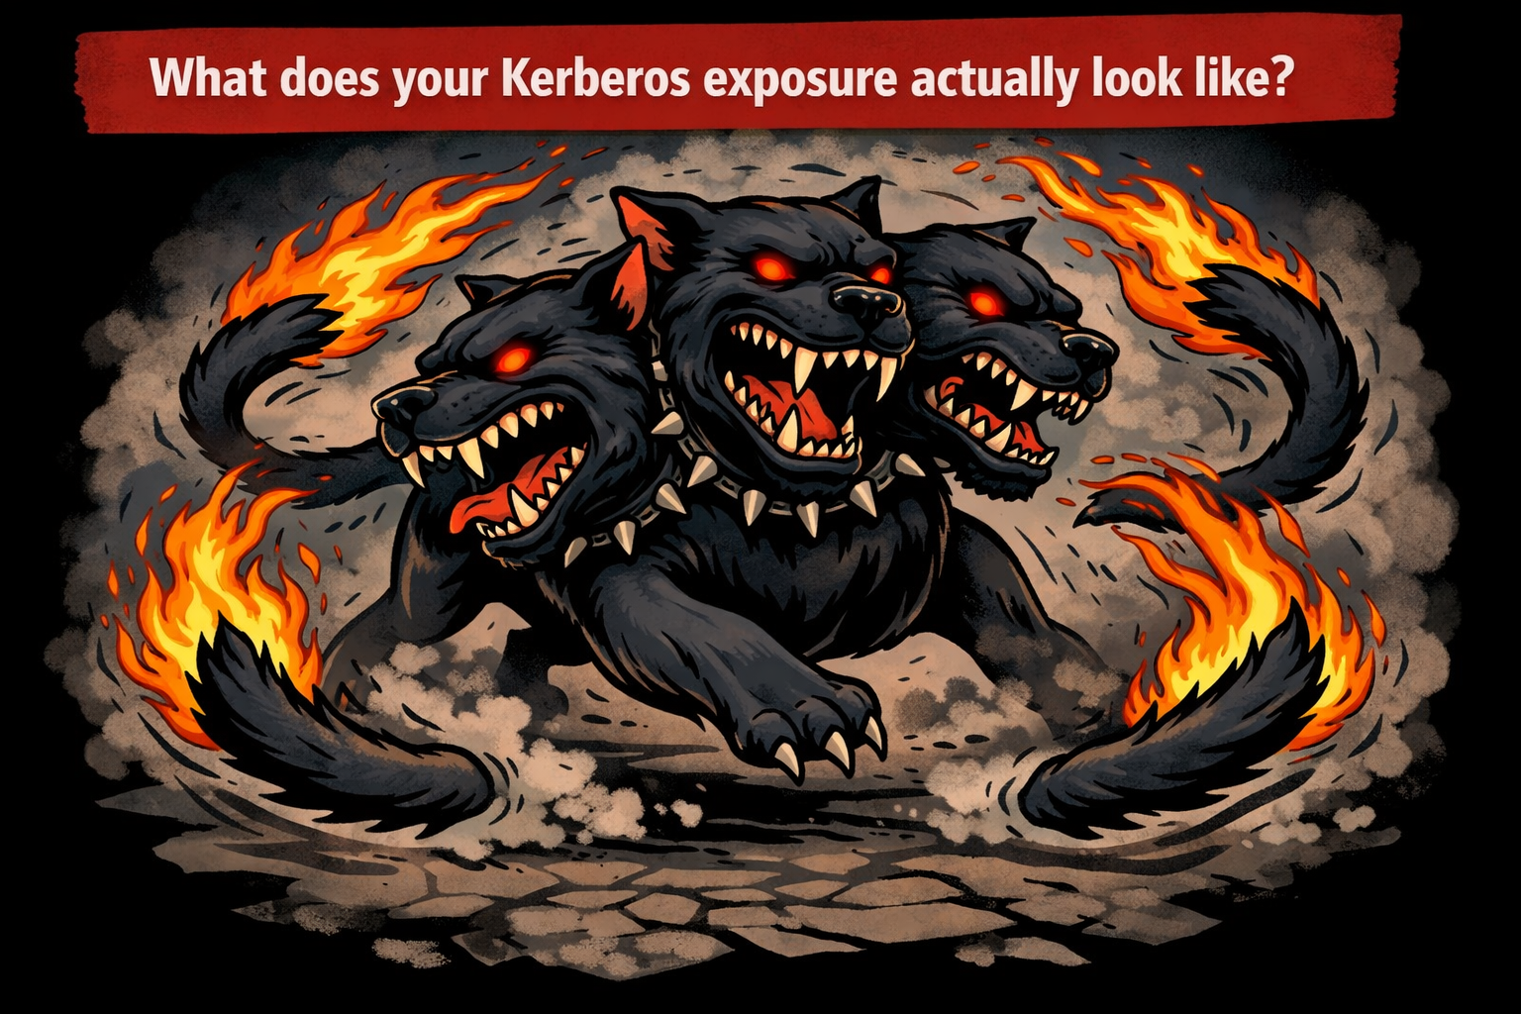
Let's Talk About Kerberos!
Trey Darley FOSDEM BoF 2026-01-31
15/30
Notes:
Slide 15 — Let's Talk About Kerberos
(~0:45 for BoF pacing)
⏱ START TIMER: 25:30
Let's make this concrete.
Kerberos — practically everyone in this room has systems that depend on it.
MIT has documented protocol-level 2038 constraints.
Protocol workarounds exist, but they're implementation-specific.
Field reports from Windows admins: ticket validity failures occurring before 2038 — the system breaks when it tries to issue a ticket that spans the rollover.
If Microsoft patches Active Directory tomorrow — who here is running just the latest Windows Server?
Who's got legacy domain controllers?
Third-party systems that speak Kerberos but aren't Microsoft's problem?
This is why disabling NTLM in brownfield environments is so hard!
This is asbestos behavior: latent, invisible, obvious only when stressed.
That pattern — one implementation fixes, the rest remain exposed — where else are you seeing that?
FACILITATOR NOTES
Timing: 0:45
Purpose: First worked example of the matrix; make the framework concrete
Key beats:
Everyone depends on Kerberos
Protocol-level constraints — not just implementation
Failures already happening (pre-2038)
One vendor patching doesn't solve ecosystem
"Asbestos behavior" — callback to central metaphor
Delivery notes:
"Who here is running just the latest..." — rhetorical, don't wait for hands
"Latent, invisible, obvious only when stressed" — slow down, let it land
Final question ("where else are you seeing that?") is a soft invitation, not a hard pivot to discussion — you're moving to the assessment slide next
Watch for:
Windows/AD admins lighting up — they know this pain well
Someone wanting to share a Kerberos horror story — note for later, keep moving
The "asbestos behavior" line may get nods
© 2026 Proper Tools. Licensed under CC BY 4.0. Attribution required; commercial use permitted.

Slide 16
Kerberos Assessment
🌍 Cross-sector
One possible assessment…
Impact
Uncertainty
Difficulty
💥 | ⁉️
 |  | 🛠️
High
GitHub Badge Format 💥⁉️🛠️🌍 High Impact /
High Uncertainty / Medium Difficulty / Cross-sector Blast Radius
Medium
Low
Trey Darley Proper Tools 2026-02-03
16/30
Notes:
Slide 16 — Kerberos Assessment
(~0:30 for BoF pacing)
⏱ START TIMER: 26:30
Here's one way to plot Kerberos.
Impact: high — authentication infrastructure, everything depends on it.
Uncertainty: high — most organizations haven't tested this.
Difficulty: medium — patches exist, but ecosystem deployment is the problem.
Blast radius: cross-sector.
Badge: 💥⁉️🛠️🌍
You might assess this differently, this is just an example.
FACILITATOR NOTES
Timing: 0:30
Purpose: Demonstrate the matrix applied; introduce badge format
Key beats:
Walk through the four dimensions quickly
Delivery notes:
"Four emoji, one string" — let it land; people will get it
Don't linger — this is a quick slide; momentum carries to glibc
Watch for:
Smiles or chuckles at the badge format — it's clicking
Someone wanting to debate the assessment — "Great, hold that thought — let's see two more examples first"
© 2026 Proper Tools. Licensed under CC BY 4.0. Attribution required; commercial use permitted.

Slide 17
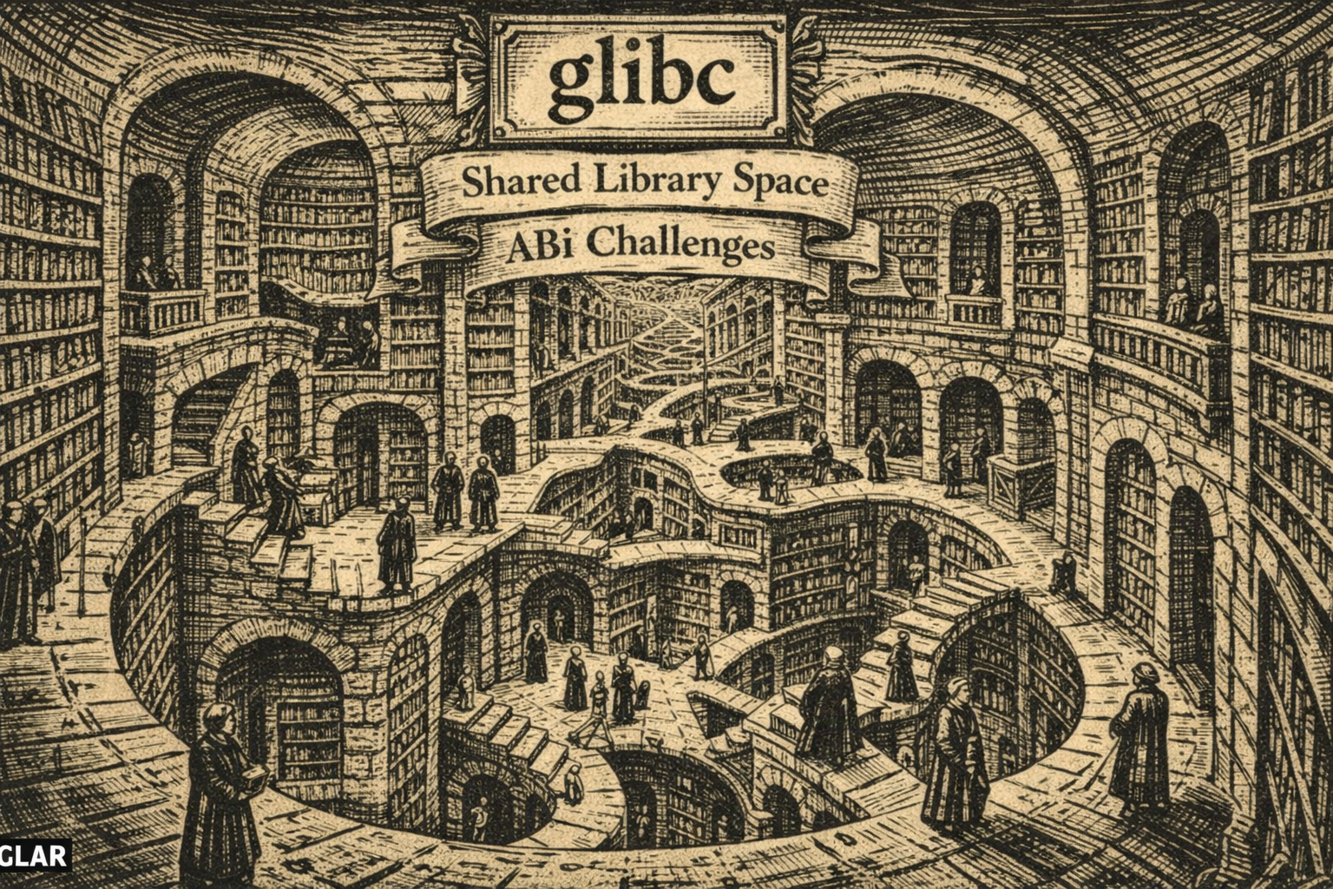
Let's Talk About glibc!
Trey Darley FOSDEM BoF 2026-01-31
17/30
Notes:
Slide 17 — Let's Talk About glibc
(~0:45 for BoF pacing)
⏱ START TIMER: 27:00
Now the one everyone asks about: glibc — the C library most Linux systems depend on.
Yes, there's been real work here. The 64-bit time_t transition is happening.
But here's the catch: glibc keeps ABI compatibility.
Think of it like this — the library is a contract.
Old programs expect the old contract.
Even when the library upgrades, those old programs still use the old interface.
So every binary compiled against the old ABI still carries 32-bit time assumptions.
Containers, vendor packages, anything statically linked, anything not recompiled — still exposed.
The library can be fixed.
The ecosystem rebuilding against it?
Different timeline entirely.
That's why "glibc is fixed" is both true and misleading.
FACILITATOR NOTES
Timing: 0:40
Purpose: Second worked example; address the most common misconception
Key beats:
glibc is the foundation — everyone depends on it
ABI compatibility = old binaries keep old behavior
"Fixed library ≠ fixed ecosystem"
"True and misleading" — the takeaway
Delivery notes:
"Think of it like this — the library is a contract" — slow down here, this is the explainer
"Containers, vendor packages, anything statically linked" — can be rapid-fire
"True and misleading" — land it, slight pause before moving on
Watch for:
Distro maintainers nodding — they live this
Confused faces on "ABI" — the contract analogy should help; if not, you can add: "Same library, two interfaces — old programs get the old one"
© 2026 Proper Tools. Licensed under CC BY 4.0. Attribution required; commercial use permitted.

Slide 18
glibc Assessment
One possible assessment…
🏭 Sector-wide
Impact
Uncertainty
Difficulty
💥 |  | ⛔
 | ✅
High
GitHub Badge Format 💥✅⛔🏭 High Impact /
Low Uncertainty / High Difficulty / Sector-wide Blast Radius
Medium
Low
Trey Darley Proper Tools 2026-02-03
18/30
Notes:
Slide 18 — glibc Assessment
(~0:30 for BoF pacing)
⏱ START TIMER: 28:00
Here's one way to plot glibc.
Impact: high — foundational, everything touches it.
Uncertainty: low — well-studied, we know where the problems are.
Difficulty: high — ABI constraints mean you can't just push a patch.
Blast radius: sector-wide — huge, but not everything. Non-glibc ecosystems exist.
Badge: 💥✅⛔🏭
You might assess this differently, this is just an example.
FACILITATOR NOTES
Timing: 0:30
Purpose: Demonstrate matrix applied to a "partially fixed" case
Key beats:
Walk through four dimensions quickly
Note the contrast with Kerberos: low uncertainty (we've looked), high difficulty (can't just fix)
Sector-wide, not cross-sector — an important distinction
Delivery notes:
Don't linger — momentum carries to satellites
Watch for:
Someone noting the uncertainty difference from Kerberos — "Exactly, that's the point"
Debate about blast radius — "Fair, we could argue that; let's see one more example"
© 2026 Proper Tools. Licensed under CC BY 4.0. Attribution required; commercial use permitted.

Slide 19
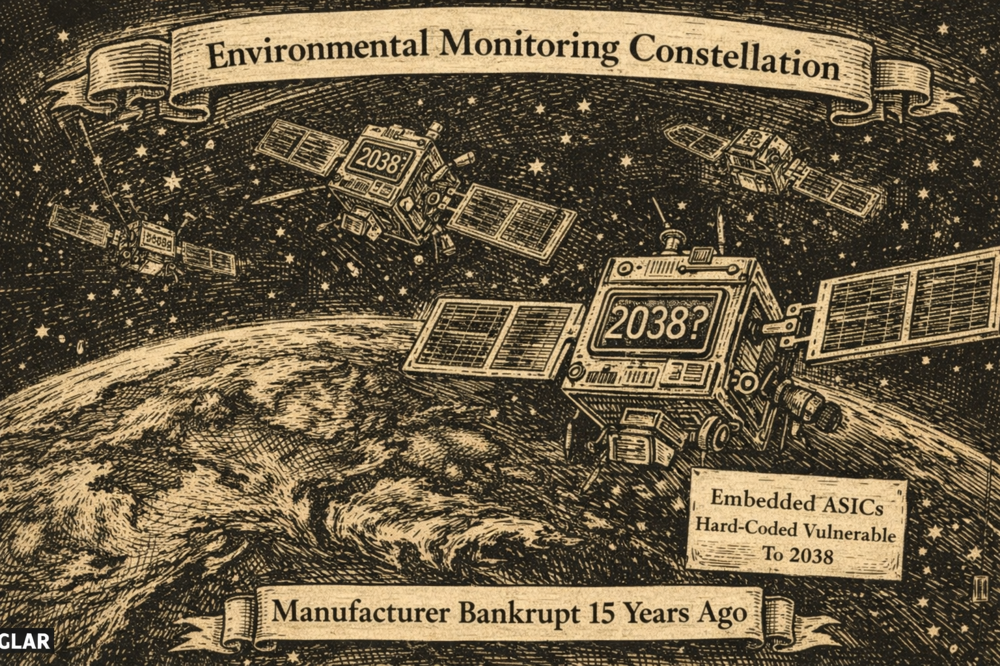
Let's Talk About Satellites!
Trey Darley FOSDEM BoF 2026-01-31
19/30
Notes:
Slide 19 — Let's Talk About Satellites
(~0:45 for BoF pacing)
⏱ START TIMER: 28:30
One more example — the nightmare scenario.
A satellite constellation launched in 2012.
Environmental monitoring.
Critical infrastructure.
32-bit time burned into ASICs.
Not firmware you can update — actual hardware.
Circuits etched in silicon.
The clock logic is physical.
The vendor went bankrupt in 2018.
Documentation is partial.
Source code is in escrow somewhere, maybe.
These satellites will still be in orbit in 2038.
You cannot patch them.
You cannot recall them.
You can only plan around them.
This is what intractability looks like — when the fix doesn't exist, and no amount of budget or coordination changes that.
Does anyone have systems like this?
Where the remediation path simply isn't there?
FACILITATOR NOTES
Timing: 0:45
Purpose: Third worked example; illustrate pure intractability
Key beats:
ASICs = hardware, not software — you can't update physics
Vendor gone, documentation gone, satellites still orbiting
"Plan around" is the only option
Intractability = no fix exists at any price
Delivery notes:
"Circuits etched in silicon" — slow down, let the permanence land
"You cannot patch them. You cannot recall them." — deliberate rhythm, like a verdict
Final question is genuine — you want the room to surface similar examples
This may produce a moment of quiet — that's okay
Watch for:
Embedded engineers nodding grimly — they know this
Someone with an even worse example — let them share briefly
The mood may get heavy here — that's appropriate; the Ascent will lift it
© 2026 Proper Tools. Licensed under CC BY 4.0. Attribution required; commercial use permitted.

Slide 20
Satellite Assessment
One possible assessment…
🏭 Sector-wide
Impact
Uncertainty
Difficulty
 | ⁉️ | ⛔
⚠️
High
GitHub Badge Format ⚠️⁉️⛔🏭 High Impact /
High Uncertainty / High Difficulty / Cross-sector Blast Radius
Medium
Low
Trey Darley Proper Tools 2026-02-03
20/30
Notes:
Slide 20 — Satellite Assessment
(~0:30 for BoF pacing)
⏱ START TIMER: 29:30
Here's how I'd plot it.
Impact: medium — not Kerberos-level, but what depends on it is critical.
Uncertainty: high — who even knows what's in those chips?
Difficulty: high — there is no fix. None.
Blast radius: sector-wide.
Badge: ⚠️⁉️⛔🏭
This is where the Difficulty column breaks your brain.
No budget or coordination makes this tractable.
You can only plan around pending system failure.
You might assess this differently, this is just an example.
FACILITATOR NOTES
Timing: 0:30
Purpose: Demonstrate matrix applied to an intractable case
Key beats:
Medium impact (surprising) — it's bad, but scoped
High uncertainty — literal unknowns in silicon
High difficulty — no fix exists at any price
"Breaks your brain" — names the emotional reality
Delivery notes:
"There is no fix. None." — flat, final
"Breaks your brain" — slight pause, let it land
Don't ask for examples here — you already did on Slide 19
Watch for:
Quiet room — appropriate, this is heavy
Someone wanting to debate "medium impact" — "Fair — depends what's downstream; that's the conversation"
Ready to pivot to the Ascent — energy shift coming
© 2026 Proper Tools. Licensed under CC BY 4.0. Attribution required; commercial use permitted.

Slide 21
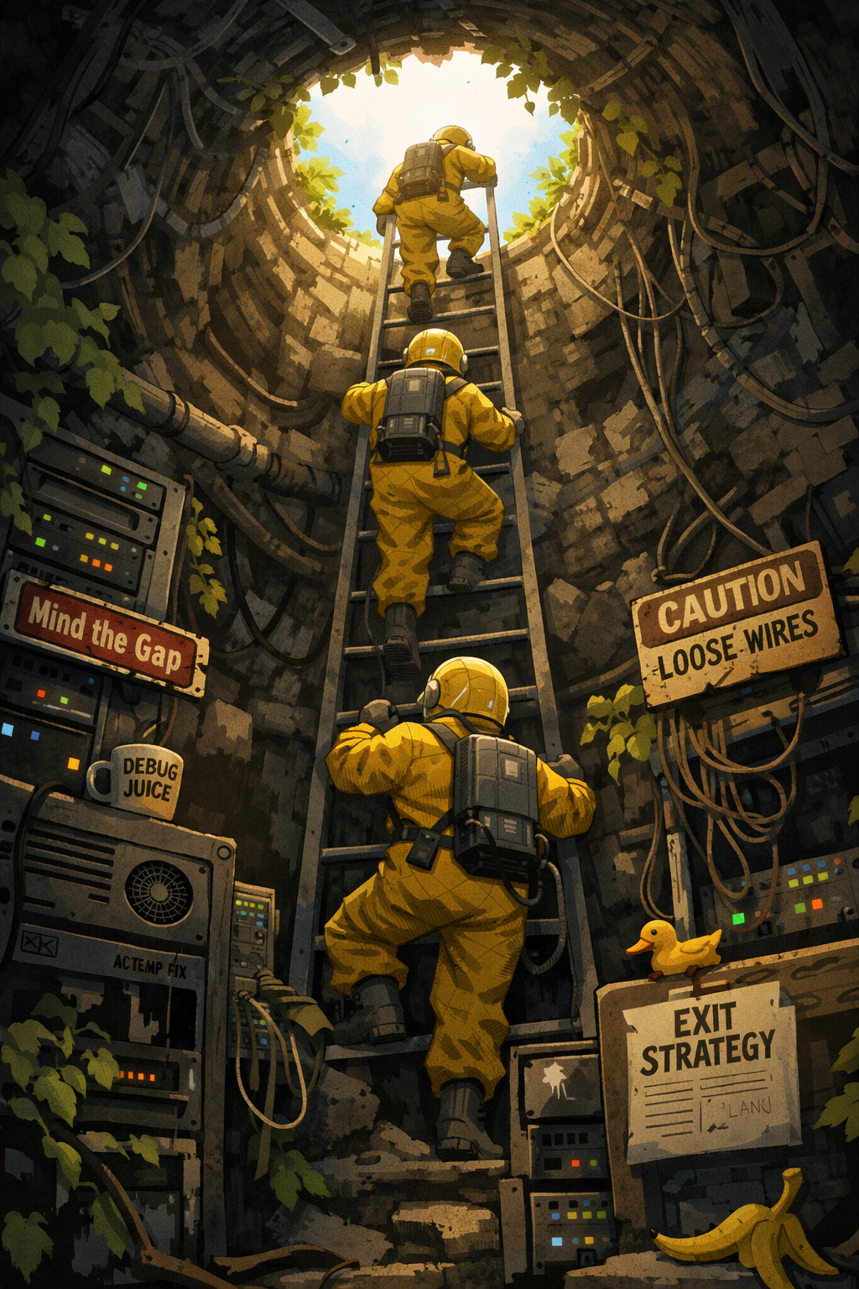
The Ascent
Trey Darley FOSDEM BoF 2026-01-31
21/30
Notes:
SECTION 4 — THE ASCENT (20 minutes)
Goal: Roll findings up into decision-grade signals. Bridge from technical reality to governance action.
Slide 21 — The Ascent
(~0:30 for BoF pacing)
⏱ START TIMER: 30:00
Okay. We've been down the stack. Protocols, libraries, hardware in orbit.
We've got a framework.
We've got three very different example exposures.
Now comes the hard part: what do you actually hand your minister?
Not the whole mess.
Not fear. Not blame.
Clear decision support for next actions.
This is the Ascent.
Technical truth in, political signal out.
Let's roll it up.
FACILITATOR NOTES
Timing: 0:30
Purpose: Pivot from technical descent to governance framing
Key beats:
Recap the journey (stack, framework, three examples)
Name the challenge: minister needs signal, not noise
"Technical truth in, political signal out" — the throughline
Delivery notes:
"Not the whole mess. Not fear. Not blame." — rhythmic triplet, land each beat
"This is the Ascent" — slight pause, marks the turn
Energy shift here: you're climbing out into the light, not going deeper
"Let's roll it up" — forward momentum, invites what's next
Watch for:
Room energy should lift slightly — you're heading toward resolution
Anyone looking fatigued — this is the home stretch, pace accordingly
If you're running long, this slide can be compressed to 15 seconds
© 2026 Proper Tools. Licensed under CC BY 4.0. Attribution required; commercial use permitted.

Slide 22
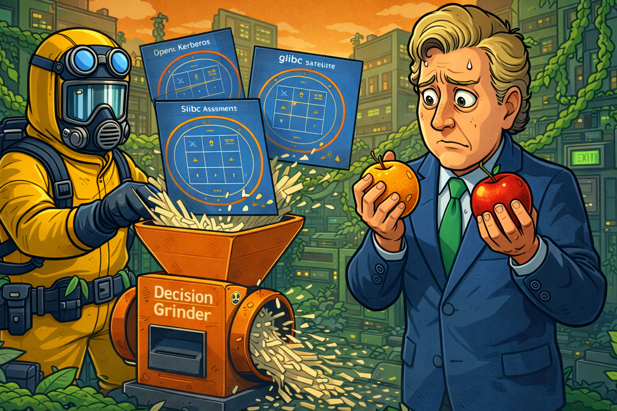
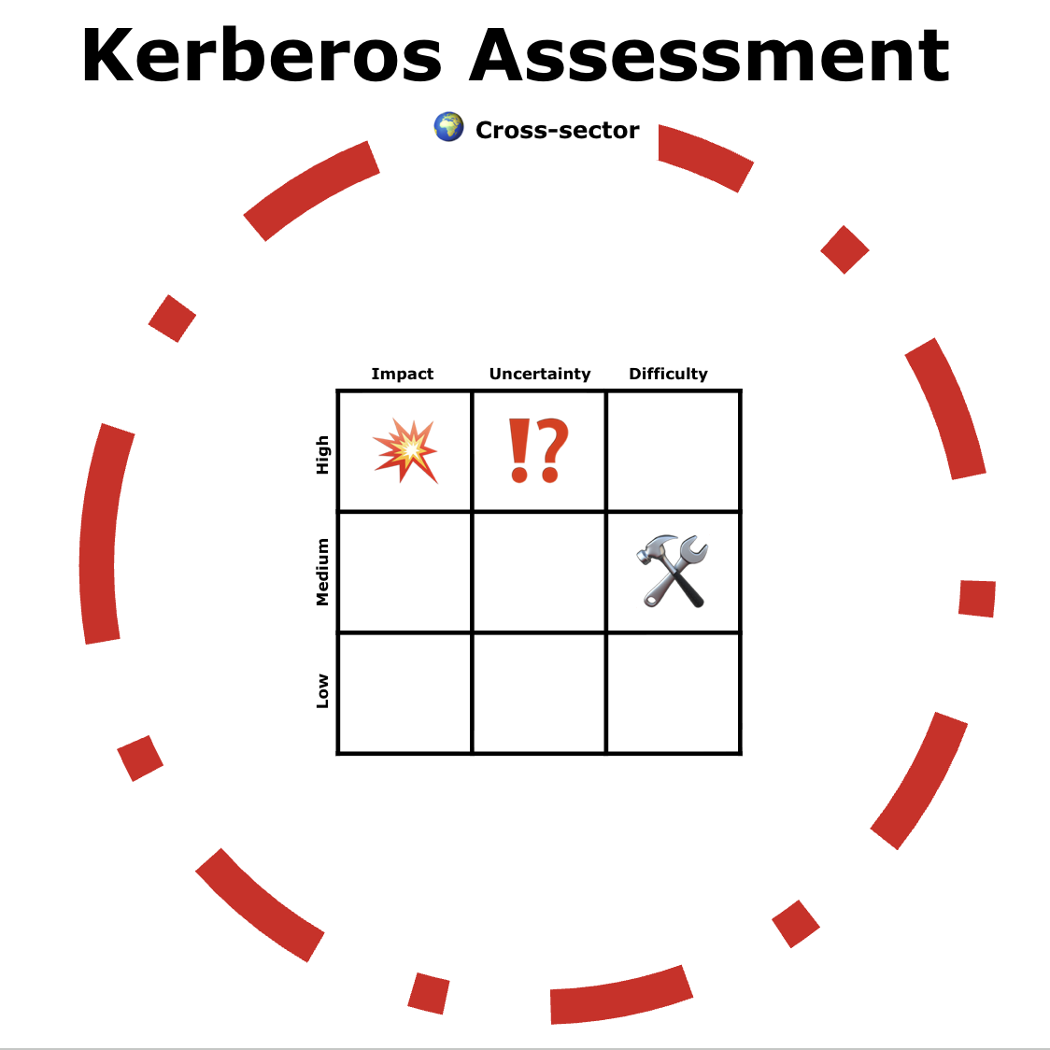
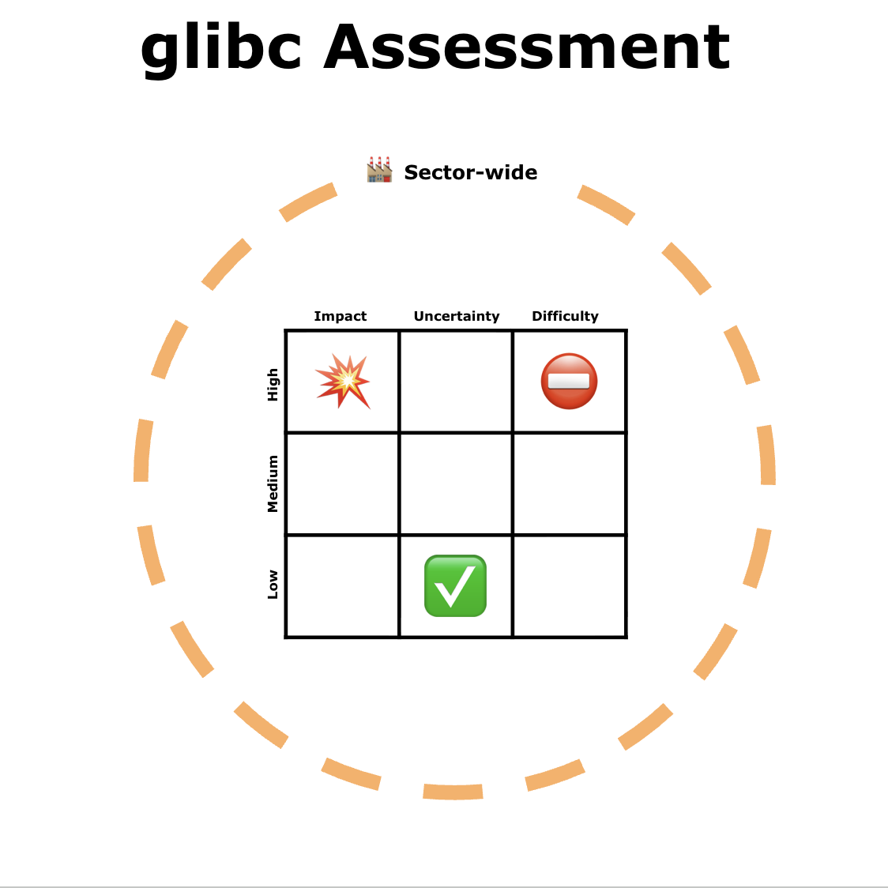
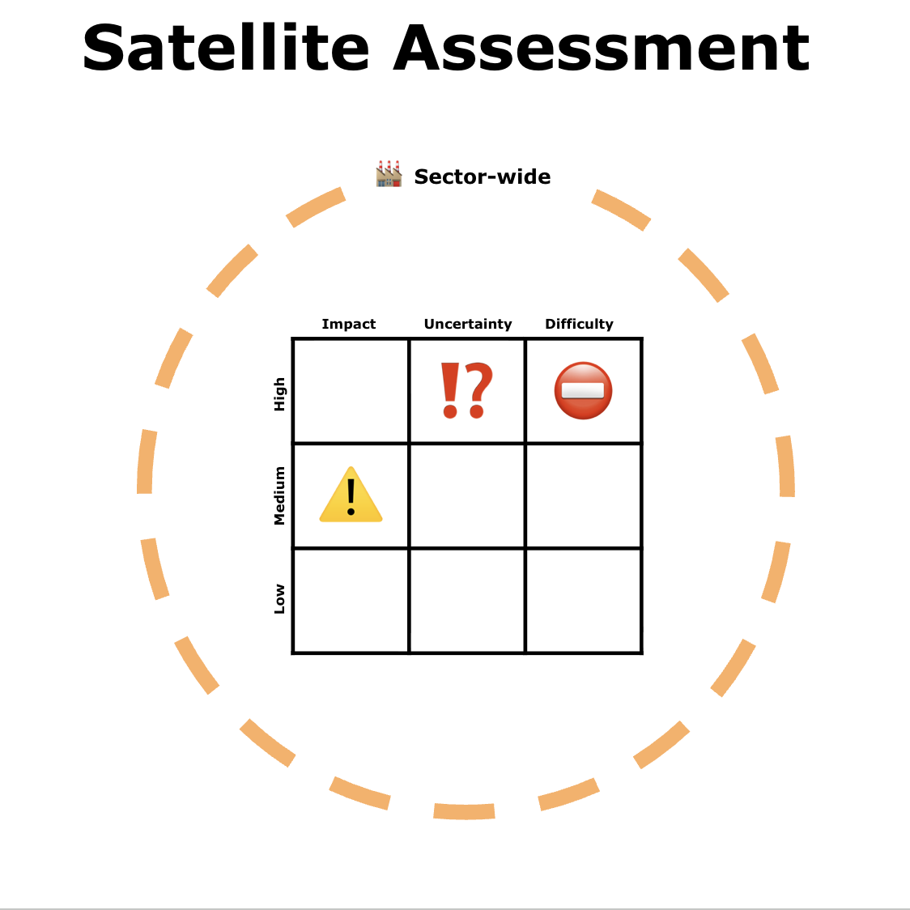
Technical truth in, decision-grade signal out
Trey Darley FOSDEM BoF 2026-01-31
22/30
Notes:
Slide 22 — Epochalypse Decision Grinder
(~0:30 for BoF pacing)
⏱ START TIMER: 30:30
So here's the problem.
Kerberos: 💥⁉️🛠️🌍
glibc: 💥✅⛔🏭
Satellites: ⚠️⁉️⛔🏭
Three completely different failure modes.
Three different timelines.
Three different owners.
And the minister is standing there holding an apple and (maybe) an AI orange, asking: "Which one do I worry about first?"
This is the rollup problem.
How do you grind these down into something politically actionable?
FACILITATOR NOTES
Timing: 0:30
Purpose: Name the aggregation challenge; set up ministerial framing
Key beats:
Three badges side by side — visual comparison
"Apple and an AI orange" — the minister's dilemma
"Rollup problem" — gives it a name
Question is rhetorical — you're about to answer it
Delivery notes:
Read the three badges quickly — don't re-explain, just list
"Three different failure modes. Three different timelines. Three different owners." — rhythmic, builds pressure
"Apple and an AI orange" — gesture to slide if the visual shows this
"How do you grind these down" — let the question hang for a beat
Watch for:
Wry smiles at "apple and orange" — the absurdity is landing
Policy folks leaning in — this is their world
Ready to move — this slide sets up, the next slides deliver
© 2026 Proper Tools. Licensed under CC BY 4.0. Attribution required; commercial use permitted.

Slide 23
What Can a Minister Actually Do?
Sufficient levers that preserve civil liberties
 | Proportionate Levers | What This Is NOT
Transparency | 📋 Disclosure Requirements | ❌ Mass surveillance
 | 🏷️ Consumer Labeling | ❌ Codebase inspection
Market shaping | 🛒 Public Procurement standards | ❌ Backdoors
 | 🛡️ Liability Safe Harbors | ❌ Criminal penalties for devs
Stewardship | 💰 Funding the Commons | ❌ Telling citizens what to run
 | 🤝 Standards & Coordination
 | 🏗️ Code & Build Escrow for Publicly-Funded Systems
Trey Darley FOSDEM BoF 2026-01-31
23/30
Notes:
Slide 23 — What Can a Minister Actually Do?
(~1:30 for BoF pacing)
⏱ START TIMER: 31:00
Before we talk about what the minister needs to know, let's talk about what they can actually do.
If all we hand them is panic, they'll reach for panic tools.
We don't want that.
Good news: almost everything useful lives far away from individual citizens.
Let me walk through the options.
Transparency: Disclosure requirements — not "you must fix this," just "have you looked, and what did you find?"
Same model as climate risk disclosure.
The state learns about systems, not people.
Consumer labeling — "supported until 2035," "not tested for rollover."
Information, not bans.
Market shaping: Procurement standards — governments buy a lot.
"Want to sell to the NHS or the railways? Show us your timestamp audit."
That's market pressure, not regulation.
Liability safe harbors — "disclose in good faith by 2030, get legal protection."
Unlocks honesty instead of concealment.
Stewardship: Funding the commons — pay for maintainer time, tooling, coordination.
Sovereign Tech Fund model.
Zero civil liberties impact.
Standards and coordination — soft power, shared language, no mandates.
Code and build escrow for publicly-funded systems — so when vendors disappear, remediation is still possible.
[gesture to right column]
What's NOT on this list:
mass surveillance,
codebase inspection,
backdoors,
criminal penalties for developers,
telling citizens what software to run.
None of that is necessary.
[BEAT]
This is a map of proportionate levers that preserve civil liberties.
Notice: none of these require knowing who uses a system — only whether the system exists and how long it's expected to live.
A minister with this toolkit needs to answer five questions…
FACILITATOR NOTES
Timing: 1:30
Purpose: Frame the policy space; reassure the room that governance doesn't require authoritarianism
Key beats:
"Panic in, panic tools out" — the risk we're designing around
Three categories: Transparency, Market shaping, Stewardship
The "What This Is NOT" column does important political work — name it explicitly
"Who vs. whether" distinction — privacy-preserving framing
Delivery notes:
Walk through the three categories using the slide structure
Gesture to right column on "What's NOT on this list"
"None of that is necessary" — firm, clear
"Five questions" — sets up the next slide, creates anticipation
Watch for:
Policy folks nodding — this is their language
FOSS folks relaxing — they were worried about Big Brother
CRA-aware folks catching "Code & Build Escrow"
Someone wanting to debate a specific lever — "Great topic for discussion, let's get through the framework first"
© 2026 Proper Tools. Licensed under CC BY 4.0. Attribution required; commercial use permitted.

Slide 24
Minister's Five Key Questions
Complexity collapses upward into five questions:
Does this stay in my portfolio — or escalate? Who else needs to know?
How much time do I really have?
What’s the cost of action vs inaction?
Can we fix this alone? Or is coordination required?
What do we tell the public?
The key is how to answer these — responsibly
Trey Darley FOSDEM BoF 2026-01-31
24/30
Notes:
Slide 24 — Minister's Five Key Questions
(~1:30 for BoF pacing)
⏱ START TIMER: 32:30
Complexity collapses upward into five questions.
This is the altitude ministers operate at.
One: Escalate or contain?
Does this stay in my portfolio, or does it touch other ministers' turf — energy, health, finance, defense?
Two: How much time do I actually have?
Not "when is the epoch?" but "when does my decision window close?"
If remediation takes eight years and rollover is in twelve, the real deadline is four years from now.
Three: Cost of action versus inaction?
What's the budget to fix this?
What's the cost if we don't?
What failure scenario do I have to defend against?
Four: Alone or coordinated?
Can we fix this ourselves, or do we need vendors, regulators, international bodies, people in this room?
Five: What do we tell the public?
If a journalist calls tomorrow, is our current posture defensible?
What would make it defensible?
These are the questions your one-pager has to answer. Not 400 matrices — these five things.
So: you've got a pile of assessments.
How do you roll them up to answer these questions?
FACILITATOR NOTES
Timing: 1:30
Purpose: Translate technical findings into governance decision points
Key beats:
Five questions = minister's operating altitude
Question 2 (time) is the key reframe — deadline ≠ rollover date
Question 5 (public) is the public accountability test
"Not 400 matrices — these five things" — compression is the point
Delivery notes:
Number each question clearly — hold up fingers if it helps
Question 2: slow down on "the real deadline is four years from now" — this is often an aha moment
Question 5: "journalist calls tomorrow" — make it visceral
Final line transitions to discussion — energy should shift to the room
Watch for:
Policy folks writing these down
Technical folks seeing this problem space differently — "Aha, this is what it's for!"
Question 2 may produce alarm or expressions of confusion, this is okay
Ready to open discussion — next slide is the rollup prompts
© 2026 Proper Tools. Licensed under CC BY 4.0. Attribution required; commercial use permitted.

Slide 25
How Do We Roll This Up?
How do you aggregate across systems?
What do you do with low-confidence findings?
How do you meaningfully communicate blast radius to non-technical decision-makers?
What information do you still need that you can't get alone?
What would make your current posture defensible?
Trey Darley FOSDEM BoF 2026-01-31
25/30
Notes:
Slide 25 — How do we roll this up?
Aim for an 8-10 minute facilitated room discussion
(~0:30 setup + 8-10 min discussion)
⏱ START TIMER: 34:00 ⏱ STOP TIMER: 44:00
So — you've got your pile of assessments. Kerberos, glibc, satellites, and a hundred others.
How do you roll them up to answer the minister's five questions?
[gesture to slide prompts]
Where do you get stuck?
Slide prompts (visible to room):
How do you aggregate across systems?
What do you do with low-confidence findings?
How do you meaningfully communicate blast radius to non-technical decision-makers?
What information do you still need that you can't get alone?
What would make your current posture defensible?
FACILITATOR NOTES
Timing: 0:30 setup, then 8-10 minutes open discussion
Purpose: Discussion — surface the rollup challenges; let the room work on the governance translation problem
Key beats:
This is the second major discussion — protect the time — use your phone or an egg timer
The prompts are on the slide; you don't need to read them all
"Where do you get stuck?" is your opening — then let the room run
Delivery notes:
Gesture to the slide — let them read
"Where do you get stuck?" — then wait; silence is okay
If no one bites after 10 seconds, pick someone: "You've been nodding — what's your slice of this?"
Keep energy focused on practical rollup, not re-litigating technical details
Watch for:
Discussion going abstract — ground it: "Give me a concrete example
One voice dominating — "Who's seeing this differently?"
Time check — protect at least 8 minutes for this; it's where synthesis happens
© 2026 Proper Tools. Licensed under CC BY 4.0. Attribution required; commercial use permitted.

Slide 26
Follow-Up Prompts
Stuck on aggregation → Do you count red-zone items? Report worst case? Build a heat map?
Stuck on uncertainty → Do low-confidence findings go in the report or not? How do you flag them?
Too technical → How do you explain blast radius to someone who doesn't think in dependency graphs?
Too abstract → Give me a concrete example — what would you actually write in that one-pager?
Missing coordination → What information do you need that you can't get from your own organization?
Premature closure → What would make that answer defensible if a journalist called tomorrow?
One voice dominating → Who's seeing this differently?
Energy flagging → "Let's make it concrete: you've got 60 seconds with the minister in an elevator. What do you say?"
Trey Darley FOSDEM BoF 2026-01-31
26/30
Notes:
Slide 26 — Follow-Up Prompts
Aim for an 8-10 minute facilitated room discussion
(Follow-Up Prompts — hidden / presenter view only)
(~0:30 setup + 8-10 min discussion)
⏱ START TIMER: 34:00 ⏱ STOP TIMER: 44:00
Stuck on aggregation → "Do you count red-zone items? Report worst case? Build a heat map?"
Stuck on uncertainty → "Do low-confidence findings go in the report or not? How do you flag them?"
Too technical → "How do you explain blast radius to someone who doesn't think in dependency graphs?"
Too abstract → "Give me a concrete example — what would you actually write in that one-pager?"
Missing coordination → "What information do you need that you can't get from your own organization?"
Premature closure → "What would make that answer defensible if a journalist called tomorrow?"
One voice dominating → "Who's seeing this differently?"
Energy flagging → "Let's make it concrete: you've got 60 seconds with the minister in an elevator. What do you say?"
FACILITATOR NOTES
Timing: N/A — steering prompts, not a script
Purpose: Facilitation tool — redirect discussion when it stalls or drifts
Key beats:
Match the prompt to the problem
Don't use unless needed — the room may carry itself
"Who's seeing this differently?" is your most versatile redirect
Delivery notes:
These are questions, not lectures — ask and step back
If you use one, wait for response before stacking another
You can paraphrase; these are guides
Watch for:
Discussion running hot — don't interrupt
Clock — you need time for synthesis and close
Natural transition: someone says something that connects to "what did we surface" — pivot to Slide 27
Transition to Slide 27: "Okay — let me reflect back what I heard."
© 2026 Proper Tools. Licensed under CC BY 4.0. Attribution required; commercial use permitted.

Slide 27
What Did We Surface?
Tooling gaps
Coordination gaps
Hot zones
Open questions
What did I miss?
Trey Darley FOSDEM BoF 2026-01-31
27/30
Notes:
Slide 27 — What did we surface?
Aim for a 2-3 minute facilitated room discussion
(~0:30 setup, then open discussion)
⏱ START TIMER: 44:00 ⏱ STOP TIMER: 47:00
Okay. Let me reflect back what I heard.
Tooling gaps: [name 2-3 that surfaced]
Fallback examples:
No scalable way to test past TLS.
No lint rules for time assumptions.
No inventory tooling that works across ecosystems.
Coordination gaps: [name 2-3 that surfaced]
Fallback examples:
Nobody knows what other distros are doing.
Vendor dependencies with no contact.
No home for cross-sector coordination.
Hot zones: [specific areas that got energy]
Fallback examples:
Embedded systems with 20-year lifetimes.
Kerberos implementations nobody maintains.
Protocol fields nobody audits.
Open questions: [things that didn't get resolved]
Fallback examples:
How do we actually fund this?
Who owns the satellite problem?
What's the threshold for escalation?
What did I miss? What else should be on this list?
[Transition] So that's what we've got. One more question before we wrap…
FACILITATOR NOTES
Timing: 2-3 minutes
Purpose: Synthesis — reflect the room's work back to them; validate contributions
Key beats:
Four categories: tooling gaps, coordination gaps, hot zones, open questions
This is improvised — fill from what actually came up
"What did I miss?" — final invitation before closing
Transition signals the end is near
Delivery notes:
Have the four categories in your head; fill them live
If discussion was thin, use the fallback examples — better than silence
Name specific contributions if you can: "As [name] said…" — makes people feel heard
"What did I miss?" — pause, give space; someone often adds something good here
Keep moving — this is synthesis, not a new discussion
Watch for:
People nodding as you reflect — you got it right
Someone correcting or adding — welcome it: "Good, adding that"
Energy lifting slightly — they see their work summarized
Anyone who contributed substantively — mental note for follow-up
Capture:
Anyone who adds something here is worth a personal follow-up within 48 hours
© 2026 Proper Tools. Licensed under CC BY 4.0. Attribution required; commercial use permitted.

Slide 28
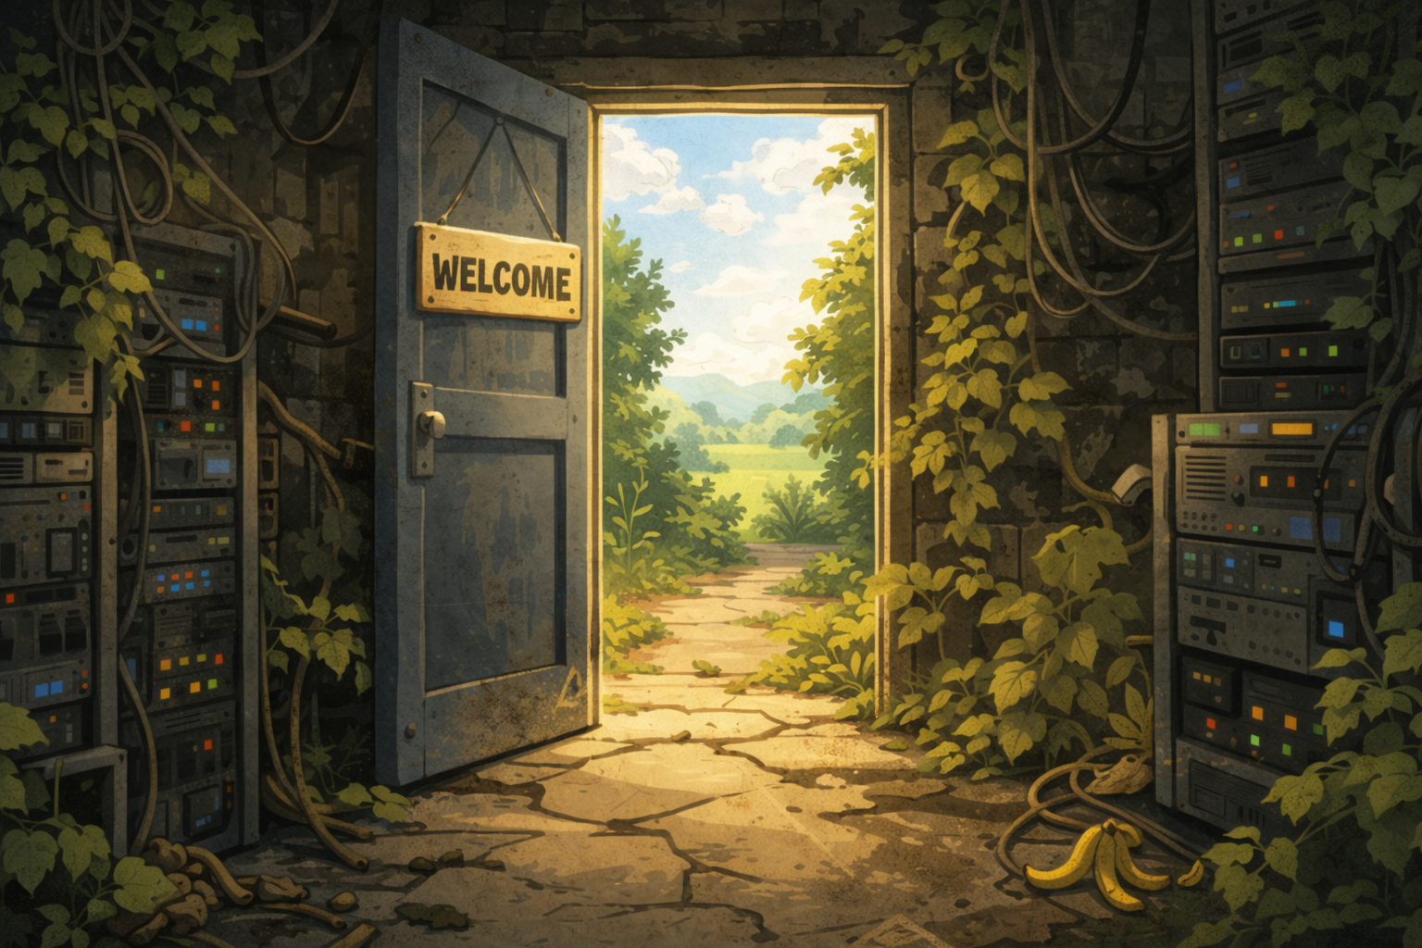
The Coordination Question
Trey Darley FOSDEM BoF 2026-01-31
28/30
Notes:
Slide 28 — The Coordination Question
(~2:00 for BoF pacing)
⏱ START TIMER: 47:00
One more question before we close — and this one matters for what happens after today.
Who else needs to be in this conversation?
What communities?
Embedded?
Distros?
Protocol maintainers?
Industrial control?
What working groups?
IETF?
ISO?
National cyber agencies?
What institutions?
The ones who fund things?
Regulate things?
Actually deploy things?
What's missing from the landscape right now?
[Let 3-4 people respond. Don't force consensus — just surface the landscape.]
FACILITATOR NOTES
Timing: 2:00 max
Purpose: Name who's not here; plant seeds for future connections
Key beats:
This is about the network, not the room
Communities, working groups, institutions — three lenses
"What's missing?" — the key question
Capture names and groups mentioned — follow-up leads
Delivery notes:
Questions can be rapid-fire — you're prompting, not lecturing
"Who else needs to be in this conversation?" — let it land, then wait
Let 3-4 people respond; don't stack more
If someone names a specific person or org, nod and note it — that's gold
Watch the clock — protect time for contact exchange
Watch for:
Specific names or orgs — write them down
"We should talk to X" — that's a follow-up lead
Energy picking up — people want to connect; channel it toward Slide 29
Don't let this become a new discussion — surface and move
Transition to Slide 29: "Thank you. These are the threads we'll keep pulling. Now — let's make sure we can actually find each other."
© 2026 Proper Tools. Licensed under CC BY 4.0. Attribution required; commercial use permitted.

Slide 29

This Is A Long-Horizon Problem…
Trey Darley FOSDEM BoF 2026-01-31
29/30
Notes:
Slide 29 — This Is A Long-Horizon Problem
(~0:30 for BoF pacing)
⏱ START TIMER: 49:00
This is a long-horizon problem. 2038 still feels far away.
But remediation timelines are long, and coordination takes time to build.
The window for action is shorter than the calendar suggests.
The people who start connecting now — in rooms like this one — are the ones who'll be ready when the ministers start calling.
When the journalists start asking.
When the first visible failures hit.
Thank you for being here.
Thank you for what you're already doing.
[BEAT]
Now go find each other.
FACILITATOR NOTES
Timing: 0:30
Purpose: Land the emotional beat; send them off with purpose
Key beats:
Long-horizon ≠ plenty of time
Coordination window is shorter than rollover window
This room is the seed
Gratitude + call to action
Delivery notes:
Slow down — this is the landing
"The window for action is shorter than the calendar suggests" — let it breathe
"Ministers… journalists… visible failures" — build the rhythm
"Thank you for being here" — genuine, make eye contact
"Now go find each other" — final line, then pause; don't step on it
Watch for:
Room energy should be quiet and focused
Some people may start gathering their things — that's okay
Hold the silence for a beat after "go find each other" before moving to Slide 30
© 2026 Proper Tools. Licensed under CC BY 4.0. Attribution required; commercial use permitted.

Slide 30
Let's Keep This Going.
📝 Sign-up for the FIRST Time Security SIG
first.org/global/sigs/time
📧 Email me: hello@propertools.be
This deck is CC BY 4.0 — use it, share it, adapt it, just give credit.
Commercial use encouraged, attribution requested.
Suggested attribution: "2038-Class Risk Exposure Matrix — Proper Tools (Trey Darley), CC BY 4.0. Source: propertools.be/commons/2038-exposure-matrix/"
Trey Darley FOSDEM BoF 2026-01-31
30/30
Notes:
Slide 30 — Let's Keep This Going
(~2:00 for BoF pacing)
⏱ START TIMER: 50:00
If you want to stay connected — whether you're working on tooling, distros, embedded, policy, or just want to keep the thread going — here's how.
The FIRST Time Security SIG is one home for this work.
We're building awareness, coordinating technical efforts, and bridging to policy conversations.
Link's on the slide, you're welcome to join us.
There's a sign-up sheet going around — name, email, one line on "what's your slice of this problem."
I'll email everyone who signs up with notes from today and a copy of the deck.
Reach me directly: hello@propertools.be.
Please — grab the people you want to talk to before you leave this room.
Don't let these connections evaporate.
One more thing: this deck is CC BY 4.0.
Use it, share it, adapt it.
Commercial use permitted.
Just give credit.
I want this to be a useful tool.
Watch LinkedIn for my post with the Slideshare.
FACILITATOR NOTES
Timing: 2:00
Purpose: Provide connection paths; send them off with action items
Key beats:
FIRST SIG = home for ongoing work
Sign-up sheet = you'll follow up
"Grab people before you leave" = the real value is in the room
CC BY = this is meant to spread
Delivery notes:
This is logistics, but keep it warm
"Don't let these connections evaporate" — slow down, make it land
"Just give credit" — light touch, not legalistic
End on "I want this to be useful" — generous, open-handed
After this slide: stay at the front if there's time, be available, let conversations happen
Watch for:
People photographing the slide — good
People approaching you — great; be present
Sign-up sheet making rounds — if it stalls, ask someone to pass it along
Be sure to grab the sign-up sheet at the end, and take a picture of it!
Room energy: some will leave, some will cluster — both are fine
Post-session:
Collect sign-up sheet before you leave
Within 48 hours: email list with notes, deck link, personal follow-up with 2-3 engaged participants
Connect anyone who should know each other
© 2026 Proper Tools. Licensed under CC BY 4.0. Attribution required; commercial use permitted.

